Slide 1
Major Federal Food Agencies
John Khouryieh, PhD
AMS303: Food Laws & Regulations
Western Kentucky University

Slide 2
Federal Agencies
Major federal food Agencies:
Food and Drug Administration (FDA)
Food Safety and Inspection Service (FSIS)/ United States Department of Agriculture (USDA)
Other federal agencies
Have limited involvement with food regulations

Slide 3
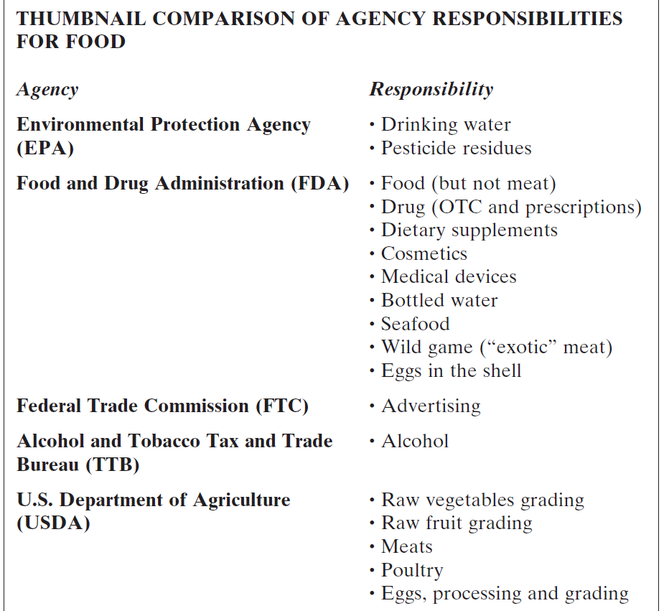
Comparison of Agency Responsibilities for Food

Slide 4
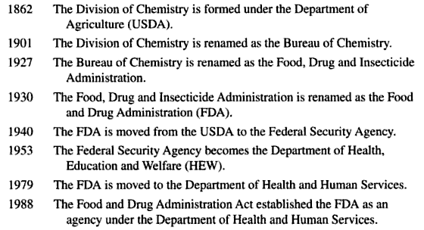
Development of the FDA
Source: Guide to food laws and regulations by Patricia A. Curtis (2005)

Slide 5
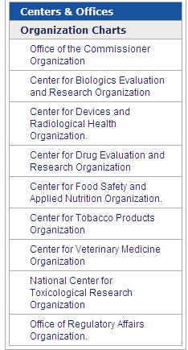
Structure of the FDA
FDA is an agency within the Department of Health and Human Services and consists of seven centers and offices

Slide 6
What does the FDA Regulate? (1 of 2)
All domestic and imported food (other than meat and poultry), including shell eggs and bottled water
Wine beverages with less than 7 percent alcohol
Human and animal drugs
Therapeutic agents of biological origin

Slide 7
What does the FDA Regulate? (2 of 2)
Medical devices
Radiation-emitting products for consumer, medical and occupational use
Cosmetics
Animal feed

Slide 8
How the FDA Protects the Public Health?
By ensuring that foods are safe, wholesome and sanitary; human and veterinary drugs, biological products, and medical devices are safe and effective; cosmetics are safe; and electronic products that emit radiation are safe.
FDA also ensures that these products are honestly, accurately and informatively represented to the public.

Slide 9
Roles of FDA in Food Safety (1 of 3)
Inspecting food production establishments and food warehouses.
Collecting and analyzing samples for physical, chemical, and microbial contamination.
Reviewing safety of food and color additives before marketing.
Monitoring safety of animal feeds used in food-producing animals.

Slide 10
Roles of FDA in Food Safety (2 of 3)
Reviewing animal drugs for safety to animals that receive them, and humans who eat food produced from the animals.
Developing model codes and ordinances, guidelines and interpretations, and working with states to implement them.
Establishing good food manufacturing practices and other production standards, such as plant sanitation, packaging requirements, and hazard analysis and critical control point programs.

Slide 11
Roles of FDA in Food Safety (3 of 3)
Working with foreign governments to ensure safety of certain imported food products.
Requesting manufacturers to recall unsafe food products and monitoring those recalls.
Taking appropriate enforcement actions.
Educating industry and consumers on safe food - handling practices.

Slide 12
FDA Publishes the Food Code
Food Code:
a model that assists food control jurisdictions at all levels of government.
Local, state, tribal, and federal regulators use the FDA Food Code as a model to develop or update their own food safety rules and to be consistent with national food regulatory policy.
Published every 4 years.

Slide 13
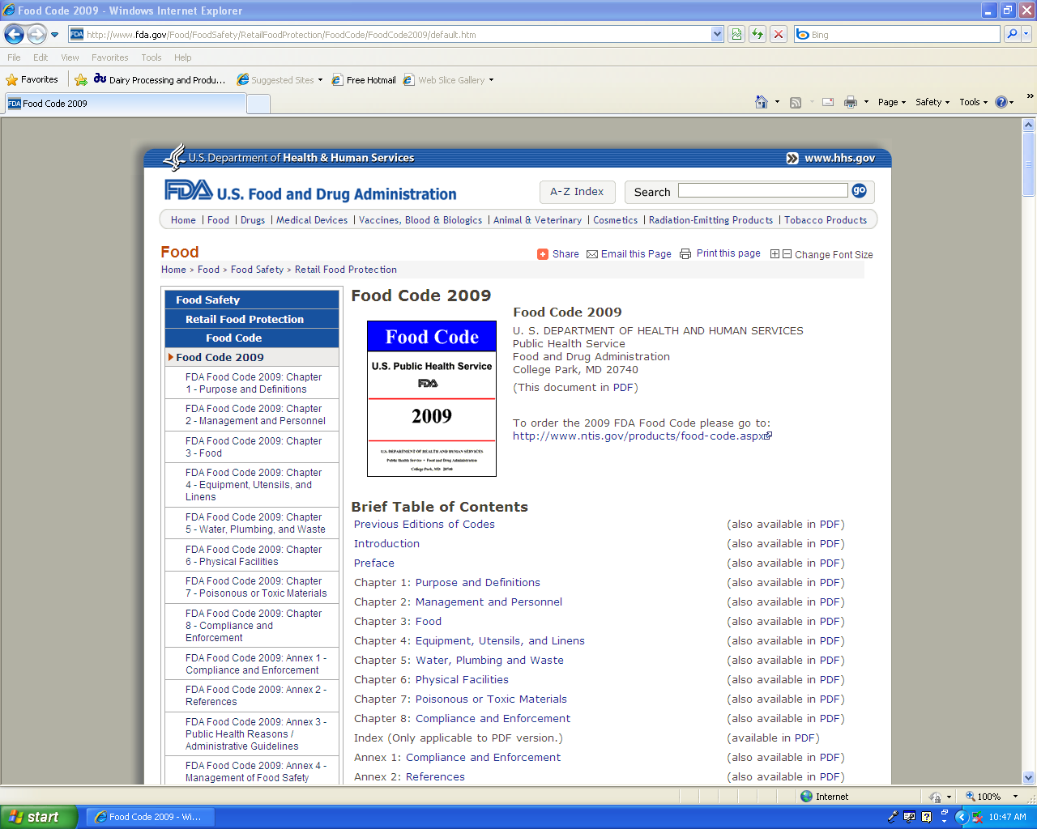
Food Code Webpage
http://www.fda.gov/Food/FoodSafety/RetailFoodProtection/FoodCode/FoodCode2009/

Slide 14
United States Department of Agriculture (USDA)
In 1862, President Abraham Lincoln founded the U.S. Department of Agriculture.
President Lincoln appoints a chemist, Charles M. Wetherill, to lead the Bureau of Chemistry, the true predecessor of the Food and Drug Administration.

Slide 15

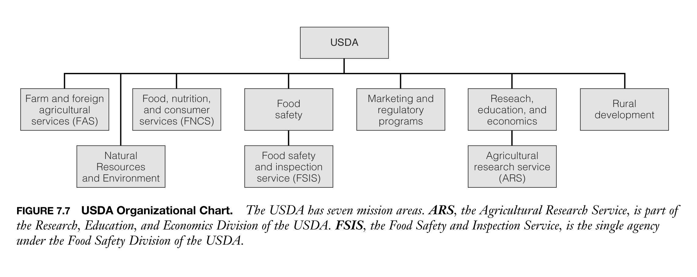
Structure of the USDA

Slide 16
Food Safety and Inspection Service (FSIS)
The FSIS is the public health agency in the USDA.
Responsible for ensuring that the nation's commercial supply of meat, poultry, and egg products is safe, wholesome, and correctly labeled and packaged.

Slide 17

FSIS Regulates
Under the authority of the FMIA, PPIA and EPIA, FSIS Regulates:
Domestic and imported meat and poultry and related products, such as meat - or poultry - containing stews, pizzas, and frozen foods.
Processed egg products (generally liquid, frozen, and dried pasteurized egg products).
Inspecting food animals for diseases before and after slaughter.

Slide 18
FSIS Food Safety Roles
Inspecting meat and poultry slaughter and processing plants.
With USDA’s AMS, monitoring and inspecting processed egg products.
Collecting and analyzing samples of food products for microbial and chemical contaminants and infectious and toxic agents.
Establishing production standards for use of food additives and other ingredients in preparing and packaging meat and poultry products, and for plant sanitation, thermal processing, and other processes.

Slide 19
FSIS Food Safety Roles (Cont’d)
Ensuring all foreign meat and poultry processing plants exporting to the U.S. meet U.S. standards.
Seeking voluntary recalls by meat and poultry processors of unsafe products.
Educating industry and consumers on safe food-handling practices.

Slide 20
Environmental Protection Agency (EPA)
EPA Oversees:
Drinking water
Pesticide safety

Slide 21
EPA
Food Safety Roles:
Establishing safe drinking water standards.
Regulating toxic substances and wastes to prevent their entry into the environment and food chain.
Determining safety of new pesticides, sets tolerance levels for pesticide residues in foods, and publishes directions on safe use of pesticides.

Slide 22
Alcohol and Tobacco Tax and Trade Bureau (TTB)
TTB Oversees
Alcoholic beverages except wine beverages containing less than 7 percent alcohol.
Food Safety Roles
Enforce food safety laws governing alcoholic beverages.
Investigate adulteration alcoholic products, sometimes with help from FDA.

Slide 23
Centers for Disease Control and Prevention (CDC)
Food Safety Roles Include:
Investigates with local, state and other federal officials sources of foodborne disease outbreaks.
Maintains a nationwide system of foodborne disease surveillance.
Develops and advocates public health policies to prevent foodborne diseases.
Conducts research to help prevent foodborne illness.

Slide 24
National Marine Fisheries Service (NMFS)
Oversees
Fish and seafood products (through a voluntary, fee-for-service system)
Food Safety Role
The Seafood Inspection Program inspects and certifies fishing vessels, seafood processing plants, and retail facilities for federal sanitation standards.

Slide 25
U. S. Customs Service
Oversees
Imported foods
Food Safety Role
Works with federal regulatory agencies to ensure that all goods entering and exiting the United States do so according to U.S. laws and regulations.

Slide 26
U.S. Department of Justice
Food Safety Role
Prosecutes companies and individuals suspected of violating food safety laws.
Through U.S. Marshals Service, seizes unsafe food products not yet in the marketplace, as ordered by courts.

Slide 27
Federal Trade Commission
Food Safety Role
Enforces a variety of laws that protect consumers from unfair, deceptive, or fraudulent practices, including deceptive and unsubstantiated advertising.

Slide 28
International Food Agencies
Food and Agriculture Organization (FAO)
World Health Organization (WHO)
Codex Alimentarius Commission

Slide 29
Useful Websites
1. Food and Drug Administration (FDA)
2. Centers for Disease Control and Prevention (CDC)
3. Food Safety and Inspection Services (FSIS)
4. Environmental Protection Agency (EPA)

